Slide 1
Burglar Alarm
Leaving Certificate Technology

Slide 2
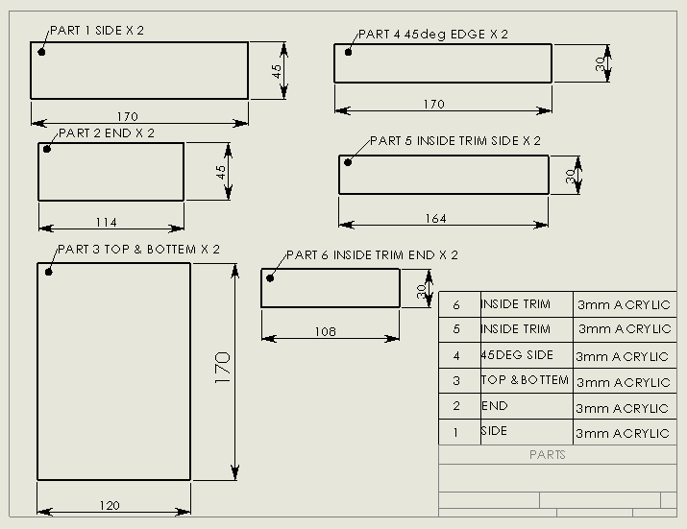
Parts List

Slide 3
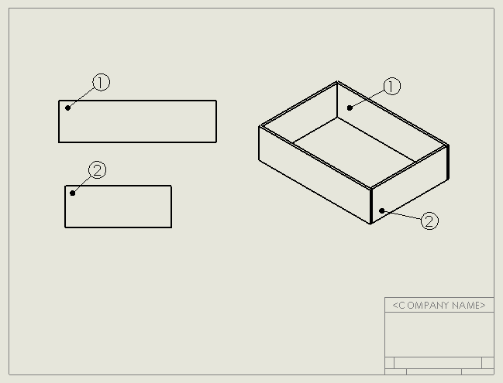
Stage 1
Use liquid solvent cement to join, Part 1 and Part 2 at 90⁰ to make a corner of the box.
Repeat procedure for the other 3 corners

Slide 4
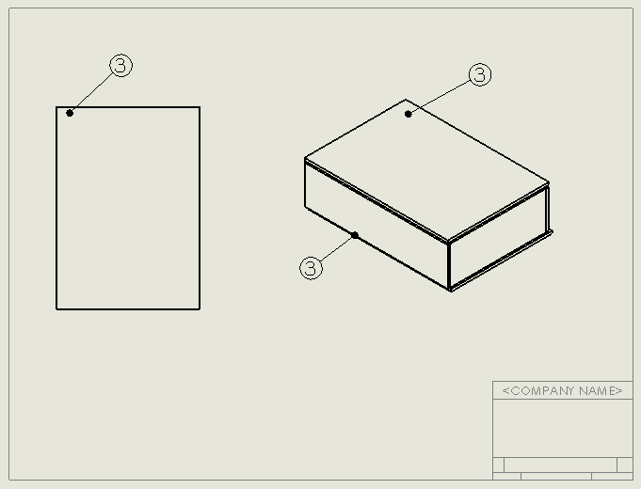
Stage 2
A 2mm trim will be removed once the glue is dry
Part 3 is over sized by 4mm in length and width
Place the 4 sides on the bottom (3) and use the liquid solvent cement to glue on the bottom
Repeat for top of box

Slide 5
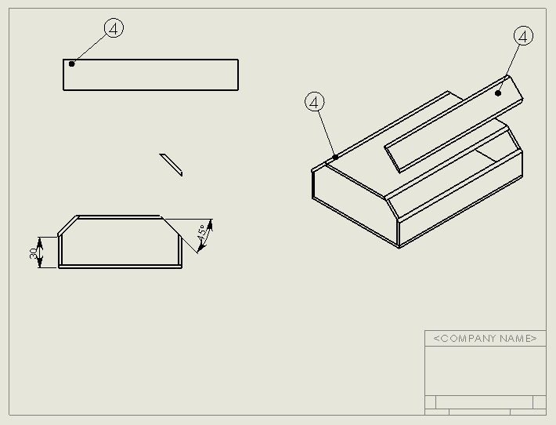
Stage 3
45deg side is again over sized in length and width.
Top edge corners are cut at 45deg using band saw
Use the band saw to cut along each line so to remove the two corners .
The 45deg sides are fixed on using liquid solvent cement.

Slide 6
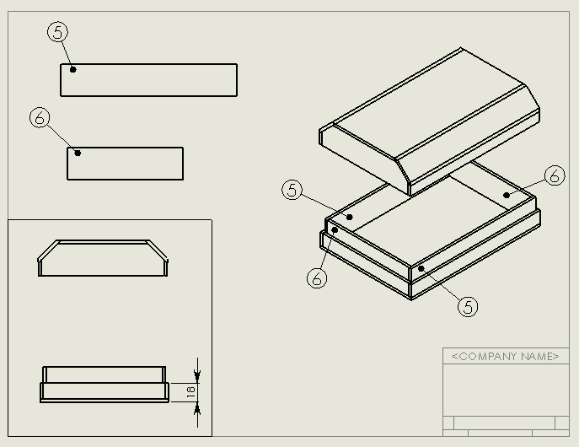
Stage 4
Top fits on and off over the trim
Fix part 5 and 6 inside box with liquid solvent cement.
Use the band saw to cut along the 18mm line so you get the top and bottom of the box
Glue the trim to the inside of the four side of the bottom half of the box.

Slide 7
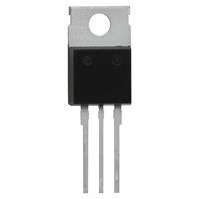
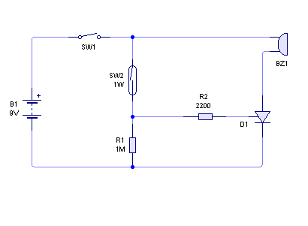
Circuit
Thyristor
gate
Cathode
anode
a
g
c
Circuit is created in circuit wizard.

Slide 8
PCB
Toggle Switch
Reed Switch
Buzzer
Power Supply
Thyristor
2k2 Resistor
1M Resistor
The circuit is then converted into a PCB and manufactured.

Slide 9
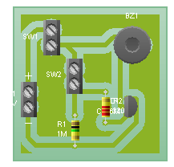
PCB with electronic components
Reed Switch
Buzzer
Toggle Switch
Thyristor
Power Supply

Slide 10
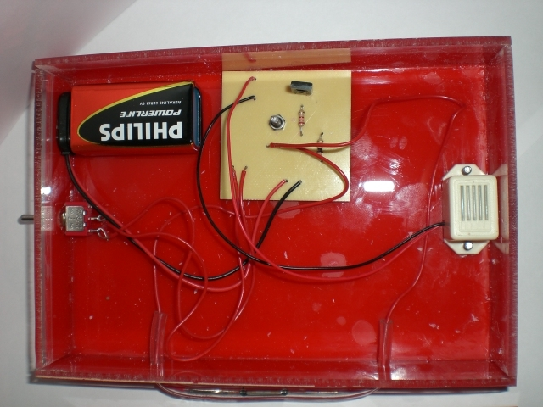
Thyristor is a lathing device. Once it is switched on by a small voltage at the gate it stays on.
Buzzer is fixed to Alarm Housing using M3 Bolts
Toggle Switch is fixed to the top of the alarm housing
The Reed Switch will be fixed to the side of the Alarm Housing. How this is done will depend on the type of Reed Switch

Slide 11
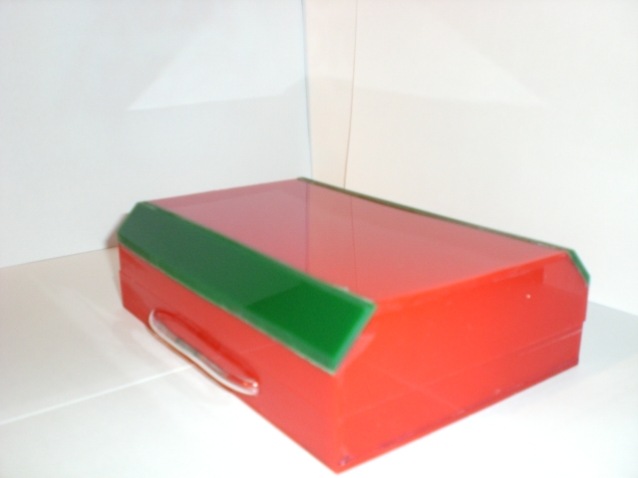
Circuit Activation
The Alarm hangs on a door with a magnet on the door frame so when the door opens the Reed Switch is activated by the magnet.

